Slide 1
Programming Fundamentals
By
Shazmeen Batool

Slide 2
Previous Lecture
Reading Data from a File
The Read Position
Reading Numeric Data From a Text File
Using Loops to Process Files
Detecting the End of the File
Testing for File Open Errors
Letting the User Specify a Filename

Slide 3
Today’s Lecture
Using the fstream Data Type

Slide 4
Using the fstream Data Type
You can use fstream to create a file object for both input and output.
You define an fstream object just as you define objects of other data types. The following statement defines an fstream object named dataFile .

Slide 5
Using the fstream Data Type
An fstream object’s open function requires two arguments, however.
The first argument is a string containing the name of the file.
The second argument is a file access flag that indicates the mode in which you wish to open the file.

Slide 6
Using the fstream Data Type
The first argument in this function call is the name of the file, info.txt. The second argument is the file access flag ios::out. This tells C++ to open the file in output mode. Output mode allows data to be written to a file.

Slide 7
Using the fstream Data Type
The following statement uses the ios::in access flag to open a file in input mode, which allows data to be read from the file.

Slide 8
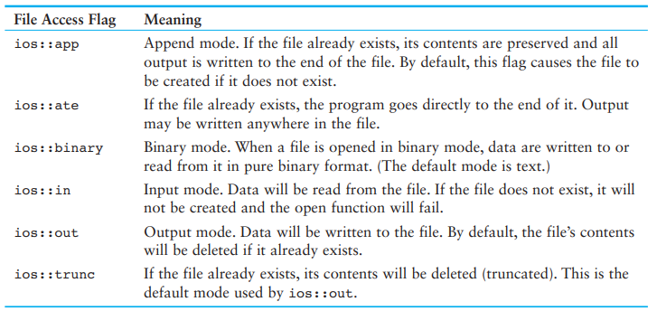
Using the fstream Data Type

Slide 9
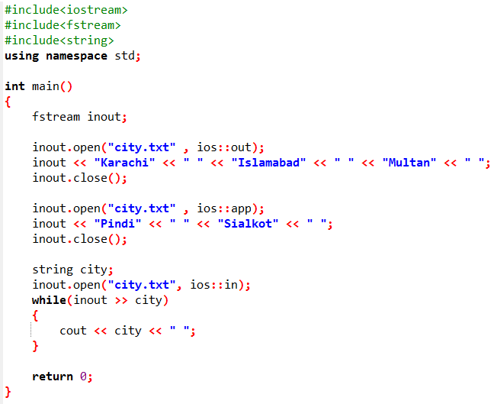


Slide 10
